Slide 1
Data Visualization
Lecture –13
Sumita Narang
Source- IIT Delhi Social Network Analysis Course by S. Mukherjea & A.A. Nanavati; IIT-D Fall 2016

Slide 2
Objectives
Data Visualizations
• Data Need for visualization
• Exploratory vs Explanatory Analysis
• Tables , Axis based Visualization and Statistical Plots
• Lessons in Data Visualization Design
• The Data Visualization Design Process
• Stories and Dashboards

Slide 3
Creating Effective Views
Even if you have chosen the best chart type(s) for your analysis, effective views do not always come naturally. Creating effective views requires effort, intuition, attention to detail—and trial and error.
Emphasize the most important data
Many chart types let you put multiple measures and dimensions in one view. In scatter plots, for example, you can put measures on the X-or Y-axis, as well as on the marks for color, size, or shape. Choosing where to put each measure depends on what kind of analysis you are doing and what you are trying to emphasize. However, a rule of thumb is to put the most important data on the X- or Y- axis and less important data on color, size, or shape.
Here, you will see a view we produced for home buyers. Its purpose is to help them understand the relationship between home price, home size, lot size, and the type of home they are interested in. What is the first relationship you see in this view?

Slide 4
Creating Effective Views contd..
Yes, the relationship between price and lot size is pretty clear. But is this the most important information for home buyers? Probably not; the relationship between price and home size probably takes precedence. For most homebuyers, finding a home with the right livable space takes priority over the lot size. This is why the chart below is more effective.

Slide 5
Creating Effective Views contd..
Orient your views for legibility
Sometimes, simple changes can go a very long way toward making your visualizations easy to interact with. For example, take a look at the view below:

Slide 6
Creating Effective Views contd..

Slide 7
Creating Effective Views contd..
Organize your views
Let’s say we want to evaluate a sales team by comparing their sales with their quotas. Our intuition tells us that we should put the two measures close together or side-by-side. This might lead to the chart shown below. But in this view, is it easy to see how well Greg Powell has performed? We know he is above quota… but by how much, exactly? With two side-by-side horizontal bars, it can be very difficult to make comparisons like this.

Slide 8
Creating Effective Views contd..

Slide 9
Creating Effective Views contd..
Avoid overloading your views
Overloading a view is one of the most common mistakes people make in data visualization. Look at the view below. Can you tell how well India is doing in terms of sales and profits per customer and department? Well, probably not because there are simply too many measures and dimensions shown in this view.

Slide 10
Creating Effective Views contd..

Slide 11
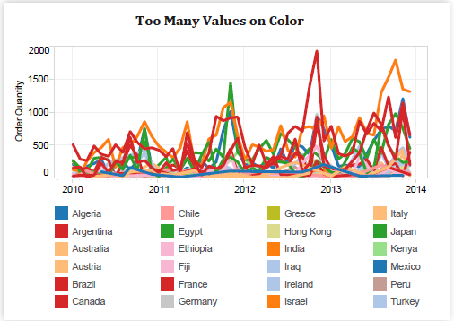
Creating Effective Views contd..
Limit the number of colors and shapes in a single view
Effective use of color and shape can help us see and understand patterns more easily. However, too many colors and shapes in one view usually defeats that purpose.
Note- Limit the number of
colors and shapes in
one view to 7-10 so
that you can distinguish
them and see
important patterns.

Slide 12
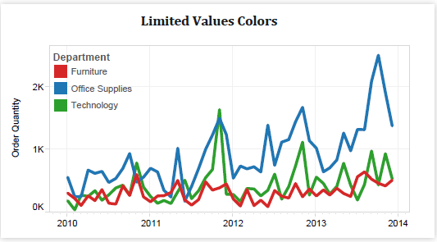
Creating Effective Views contd..

Slide 13
Creating Effective Views- Summary
Emphasize the most important data
Orient your views legibly
Arrange your views properly
Avoid overloading your views
Limit the number of colors and shapes in a single view

Slide 14
Design Holistic Dashboards 1/
A dashboard is a collection of several related visualizations shown on a single page—and usually tied together through interactivity. Dashboards increase the analytical power of your visualization by showing multiple perspectives in the same location. They can also be used to combine multiple types of data in a single location.
1. General guidelines
When designing a dashboard it’s important to structure it in a way that is accessible to your audience. For example, in below example, this dashboard guides you sequentially through each important piece of the story: the crime locations, the day of the week, and the crime frequency. In addition, it’s hard to miss the interactive panel on the top right and the interactive instructions that are subtly embedded in the titles.

Slide 15
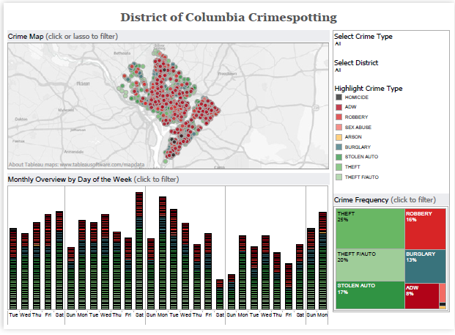
Design Holistic Dashboards 2/

Slide 16
Design Holistic Dashboards 3/
The following guidelines will help you design great dashboards:
Place the most important view at the top of your dashboard, or in the upper left corner. When looking at a dashboard, your eye is usually drawn to that corner first.
If your visualization has chained interactivity (the first view filters the next view which filters the last view, etc.), structure them from top to bottom and left to right. That way, the final view to be filtered will be on the bottom, or bottom right.
Unless there is an absolute need to add more, limit the number of views in your dashboard to three or four. If you add too many views, the big picture can get lost in the details. Remember, you can always use multiple dashboards to tell one story!
Avoid using multiple color schemes in a dashboard—unless there are natural’ and independent color schemes in your data.
If you have multiple filters, try to group them together with a layout container. A light border around them gives a subtle visual cue that they have shared features. The right, top, and left sides of the dashboard are all great places to put your filters.
If a legend applies to all of your views, place them together with all of your filters. If a legend applies to one or a few more views, place it as close to those views as possible.

Slide 17
Design Holistic Dashboards 4/
2. Give the wheel to your users with interactivity
How to use interactivity well, but remember that interactive views should only be used when it is necessary: you need to guide a story, encourage user exploration, or there is too much detail to show all at once.
In the views below, sub-headings suggest interactivity by using verbs such as “Select,” “Highlight” and “Click.”
2.1 Highlighting
Highlights let you quickly show relationships between values in a specific area or category—even across multiple views. One of the best things about highlighting is that it preserves the context of the rest of the points (unlike filtering which we will discuss later).
While designing highlights on a dashboard, ask yourself these questions: What
are your users interested in? Will a highlight function help them see patterns
in your data more easily? Are there relationships in your data that you’d like to
emphasize? Which views or data fields do you want to build your highlights upon?
Would it help you make a particular point by having something highlighted initially
when you publish?

Slide 18
Design Holistic Dashboards 5/
In this example, we make the highlight function available across all views by crime type, meaning that when you click on a particular crime type in any view, the data related to that crime type gets highlighted in all the other views. Now we can more easily see where robbery occurs in the city—as well as the number of occurrences each day and its percentage of total crime—all at the same time.

Slide 19
Design Holistic Dashboards 6/
2.2 Filters
Filters are great ways to enable multi-level data exploration and user driven data analysis. Filters let you slice data from different angles or drill down to a more detailed level. The following steps will help you create effective filters:
Think about what you want your filters to do.
Determine which types of filters to add.

Slide 20
Design Holistic Dashboards 7/
In addition to these steps for creating effective filters, the following tips will help you optimize the efficacy of your filters:
Try to apply filters to all the views in one dashboard unless there is a strong reason to have separate filters for each view--in which cases filters should be placed as close as possible to the views it filters. In situations where you have multiple dashboards, a conscious decision has to be made as to how you would like your filters to apply to your views Arrange your filters in meaningful orders, such as by date, country, state, city, or business segment. Make sure you turn on the Show Less Value button if your filters have a cascading effect. For example, you have State as the first filter and then City as the second filter, you should turn on Show Less Value button on the City filter—that way, you will only see cities in the state your users select.
Make sure the values in the quick filter are ordered in a way that makes sense for your data. For example, instead of listing classes alphabetically, you might order them by popularity.
Add dynamic titles that represent the current filter selections. That way your users always know what views are being filtered as well as what the selections are.
Remember that a field does not have to be in use in order for you to filter by it. In other words, you can have a bar chart showing the GDP of twenty countries, and then add a filter on population to show only those countries with a population over 100 million. These “slicing” filters are very powerful.

Slide 21
Design Holistic Dashboards 8/
Hide filters from your audience if they don’t add value to your view. Not all filters have to be shown to your audience. For example, a common way to clean up extraneous data is to exclude null values. That’s a filter that you probably don’t want to show on the dashboard.
Consider including a “apply” button to your filter if the list of choices in your filter is long and each click results in automatically update which causes a lag for the users.
Decide if you want users to be able to select “All” in your filter—or just be able to go to one. Tableau allows for both, so figure out which makes sense and set your filter settings accordingly.
Remember that slider filters are great for date and numerical values—while list filters are better for categorical data.
Always test your filters after applying them to your dashboards. Try out as many different combinations (including weird, nonsensical selections) just to make sure nothing bizarre happens with filter interactions. You can easily get into a situation where the combination of filters returns no result – that can be disorienting for users and we should try to prevent it.
Don’t forget to check the initial state of your views before publishing. Be deliberate about the first impression you create for your viewers. Sometimes it is also a good technique to publish with selections so users discover interactivity sooner. If a single point is already clicked, they might be more likely to interact.

Slide 22
Design Holistic Dashboards 9/
2.3 Hyperlinking and using the power of the web
URL actions allow you to embed a hyperlink that points from your dashboards to a Web page, file, or other web-based resource. You can use URL actions to link to information hosted outside of your data source.
3. Sizing: Making sure your visualization is visible
Dashboards are set to a fixed default size that is intended to work well on a typical computer desktop. However, when you publish (to the web, in a blog, for a presentation, etc.) you may find yourself more limited. No matter where you are publishing, be sure to construct your visualization at the size that you will eventually publish at—and use the Range sizing feature to avoid scrollbars or scrunched views.
4. Scrollbars
When you republish a visualization at a different size than the original, you often end up with scroll bars like the ones shown below. If you are changing the size of a visualization that you have already embedded in a website, make sure to re-embed it with the new code.
Be careful while resizing your views; you don’t want them to become “scrunched.”

Slide 23
Tips Summary for Perfect Dashboards 1/
Color TV looks better than black and white: Use color visualizations
Try to use no more than two color palettes. Make sure to use non-overlapping scales like the ones shown below.
Select semantically meaningful colors if they apply to the context of your data.
If the meaning behind your color choice isn’t obvious, or your visualization does not obviously label the color, make sure to include a legend.
When using a diverging color palette, the midpoint and end points should be meaningful. Zero is often a meaningful midpoint.
Avoid adding color encoding to more than 12 distinct values.

Slide 24
Tips Summary for Perfect Dashboards 2/
2. Fonts
The following have been selected by our resident “visualization wizards” for their readability and visual appeal:
Trebuchet MS or Verdana (especially for tables and numbers)
Arial
Georgia
Tahoma
Times New Roman
Lucida sans
In addition, Calibri and Cambria are suitable for tooltips (see below), but are not recommended for use in any other part of a visualization.
It’s important to consider the color of your fonts. As a general rule, axes and labels should be dark grey (this keeps them from distracting viewers’ attention away from the visualization). Try to keep it to 2-3 (Font) colors per page.
If you use different fonts and styles throughout your visualization, make sure to check back over it to make sure the formatting is consistent.
Lastly, never make a change in adjacent text that modifies more than one attribute of a font (such as size, boldness, color, or serif quality).

Slide 25
Tips Summary for Perfect Dashboards 3/
3. Tooltips tell the story
Tooltips—the text boxes that pop up when you hover over an object—can make the difference between a user loving your visualization and not understanding it.
The following step-by-step example provides tips for improving a basic tooltip:
Begin with the basic tooltip. Use the front that anti-aliases properly (or does not get pixelated) online. Calibri and Cambria typically work well, but the default, Arial, is not bad either.
Next, identify the most important part of the tool tip and make that your title. In this example, the United States is clearly the subject of the tooltip, so it has been bolded and displayed in 16-point font. You can also add data to the title when applicable. For instance, if we were looking at states as well as countries, we could format the title to read “United States – Wyoming.” Think of it as you would a sports card (e.g., “Kobe Bryant – Los Angeles Lakers”).
Next, change the measure names to make them specific and understandable. “Number of records” does not mean much, but “Number of Planes” is very descriptive. “Value” is also abroad term that can raise more questions than answers. “Average Price could be better.”
Last but not least, make sure that units are included for all numbers in your tooltips.

Slide 26
Tips Summary for Perfect Dashboards 5/
4. Make intelligent axes or you’ll just have pretty rectangles
The following components can help you create intelligent axes:
Fixed axes: By default, the axis range automatically adjusts based on the data in your view. If that view is going to be filtered and changed (such as with quick filters or filter actions), your audience might not notice the resulting change in the axis range, and could therefore be misled. Changing axes also makes visual comparison very difficult. You can set the axis to a specific, fixed range to avoid any potential confusion.
Axis gridlines: If it isn’t practical to create fixed axes (such as if you’re dealing with a large range of data), add gridlines to the view. Doing so can signal to the reader that the axes are changing. Reference lines can are also very effective at achieving the same result. However, they should be kept relatively subtle—you don’t want to distract users from key elements of your view.
Axis labels: Make sure that axis labels are appropriate and include units when necessary.
Axis tick labels: Make sure that the values
on your tick marks are also formatted properly
(e.g., currency should have a symbol and the
right number of decimal places).

Slide 27
Tips Summary for Perfect Dashboards 6/
5. Labeling your visualization in all the right places
Mark labels (the labels on your data points) can help you tell your story quickly and succinctly. It is often much easier to read a mark label than to mouse over a data point for its tooltip. Select Format > Mark Labels to turn on labels.
You can select from the following mark label options:
Labels on selection: This labels the selected marks in the view. If several marks that are close together, you may want to select a different option to avoid clutter. This also applies to labels on highlight.
Labels on min/max: This labels the outliers by marking the minimum and maximum values in the view.
Labels on highlight: This labels the highlighted marks in the view.
Labels on line ends: This labels the ends of the lines in the view. You can specify which ends to label (just the beginning, just the end, or both ends).

Slide 28
Evaluating Your Masterpiece 1/
Once you’ve designed each important component of your visualization, it’s time to take a step back and evaluate your masterpiece. Are all the elements of your design working together well? Checklist –
What questions are you trying to answer?
Does this visualization answer all of your questions?
Is the purpose of the visualization clearly explained in its title or surrounding text?
Can you understand the visualization in 30 seconds or less, without additional information?
Does your visualization include a title? Is that title simple, informative, and eye-catching?
Does your visualization include subtitles to guide your viewers?
Do you have the right chart type for your analysis?
What types of analysis are you performing?
Have you selected the most suitable chart type(s) for your types of analysis?
Have you considered alternative chart types that could work better than the ones you have chosen?

Slide 29
Evaluating Your Masterpiece 2/
Are your views effective?
Are your most important data shown on the X- and Y-axes and your less important data encoded in color or shape attributes?
Are your views oriented intuitively—do they cater to the way your viewers read and perceive data?
Have you limited the number of measures or dimensions in a single view so that your users can see your data?
Have you limited your usage of colors and shapes so that your users can distinguish them and see patterns?

Slide 30
Evaluating Your Masterpiece 3/
Is your dashboard holistic?
Do all your views fit together to tell a single story?
Do all your views flow well from one to the next? Are they in a good order?
Do your most important views appear in the top or top-left corner?
Are secondary elements in your dashboard placed well so they support the views without interrupting them?
Are your filters in the right locations?
Do your filters work correctly? Do views become blank or downright confusing if you apply a filter?
Do your filters apply to the right scope?
Are your filter titles informative? Can viewers easily understand how to interactive with your filters?
Are your legends close to the views they apply to?
Is your legend highlight button set to “on” or “off” according to your preference?
Do you have filter, highlight or URL actions? If so, do they work?
Are your legends and filters grouped and placed intuitively?
Do you have scrollbars in your views? If so, are they acceptable ones?
Are your views scrunched?
Do your views fit consistently well when you apply filters?

Slide 31
Evaluating Your Masterpiece 4/
Did you perfect your work?
Do all the colors on your dashboard go together without clashing?
Do you have less than 7-10 colors on your dashboards?
Do you use fonts consistently in all of your views and no more than three different fonts on one dashboard?
Are you labels clear and concise? Are they placed optimally to help guide your viewers? Make sure subtitles are formatted to be subordinate to the main title.
Are you tooltips informative? Do they have the right format so that they’re easy for viewers to use?

Slide 32
Taking Stock: Lessons Learned
Lesson 1:
Trust is a key design issue. If you do not design your views properly, they will likely not be trusted by the savvy people who are looking at them.
Lesson 2:
Make sure that your visuals are Expressive and that they convey the data accurately.
Lesson 3:
Make Effective use of your visuals by exploiting human perception. The following rules will help you to make Effective visuals:
Use graphical vocabulary properly.
Utilize white space.
Avoid unnecessary material and clutter.
Lesson 4:
Make sure your views include Context. Titles, captions, units, commentary – all these things help your audience to better understand your data view. Always strive to tell stories with your data and your visuals. Understand that good stories involve more than just data and consider the following:
Mind your aesthetics and know that what is effective is often affective. In other words, an effective view can create an emotional response and a genuine communication to your audience.
Style is also important. Make sure that your views are consistent and pleasing to the eye. Your views are representative of who you are and what you care about.
Views can be playful. Interactive views that people can play with are very engaging. Interactive elements allow your audience to manipulate the data, ask and answer questions, and arrive at findings on their own. This helps to foster Trust in your data.
Make your views vivid and memorable. Pay attention to structure and context.

Slide 33
More Detailed Papers
https://www.tableau.com/sites/default/files/media/designing-great-visualizations.pdf
https://www.tableau.com/sites/default/files/whitepapers/752750_core_why_visual_analytics_whitepaper_0.pdf
http://cdnlarge.tableausoftware.com/sites/default/files/whitepapers/visual_analysis_for-everyone.pdf
http://www.tableau.com/sites/default/files/media/whitepaper_visual-analysis-guidebook_0.pdf

Slide 34
Extra Reading
Data Visualization Tools

Slide 35
Data Visualization Tools
Key Features required in Data Visualization Tools
Types of Data Visualization Tools
Popular Commercial tools
Popular Python Libraries for Data Visualization

Slide 36
Data Visualization Tools - Key Features
Overview: Gain an overview of the entire collection
Zoom : Zoom in on items of interest
Filter: Filter out uninteresting items
Details-on-demand: Select an item or group and get details when needed
Relate: View relationships among items
History: Keep a history of actions to support undo, replay, and progressive refinement
Extract: Allow extraction of sub-collections and of the query parameters
Shneiderman,
1996

Slide 37
Tool Types
2 Main Types:
Systems providing visualizations
Tableau
PowerBI
Gephi
Pajek
NodeXL
TouchGraph
Toolkits that can be used to build systems

Slide 38
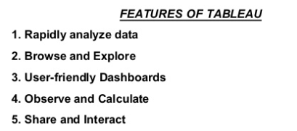
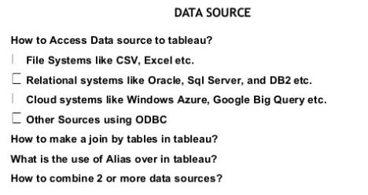
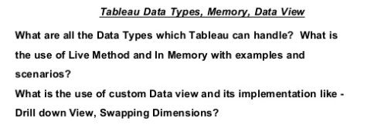
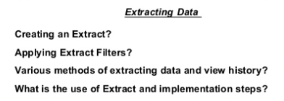
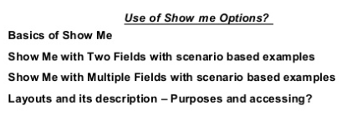
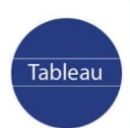
Tableau
https://www.slideshare.net/seethaBTS/tableau-ppt

Slide 39
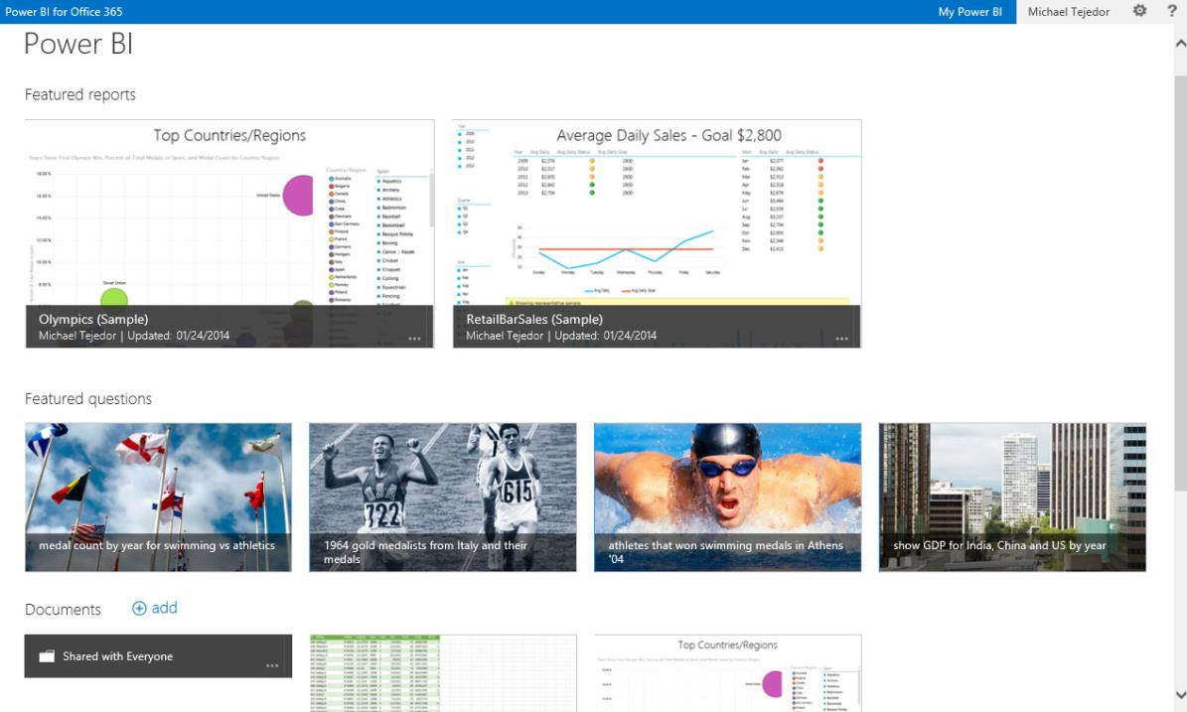
Share & collaborate with Power BI for Office 365
BI Sites
Quickly create collaborative BI sites
Shared Queries
Data Refresh
Data Search
Mobile Access
Natural Language Questions
http://download.microsoft.com/download/7/C/A/7CA1E397-15A1-4667-BE6E-AE530BDB995E/Power-BI%20_%20GA-deck.pptx
Notes:
Collaborate and stay connected with Office 365: Extends Self-Service BI with ease of collaboration and sharing of reports and data sets which reducing friction from deployment and adoption.
Power BI Sites – quickly create collaborative BI sites for your team to share reports. Larger workbook viewing is now supported (up to 250MB) so that users can view and interact with larger workbooks through the browser. Power BI sites provide a highly visual experience for sharing reports including live report tiles to ease in locate the right report quickly.

Slide 40
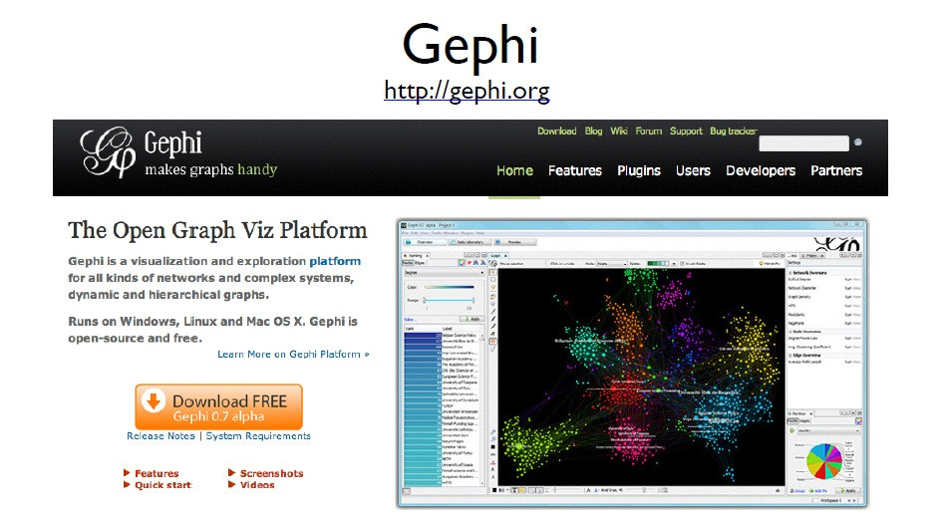
Gephi

Slide 41
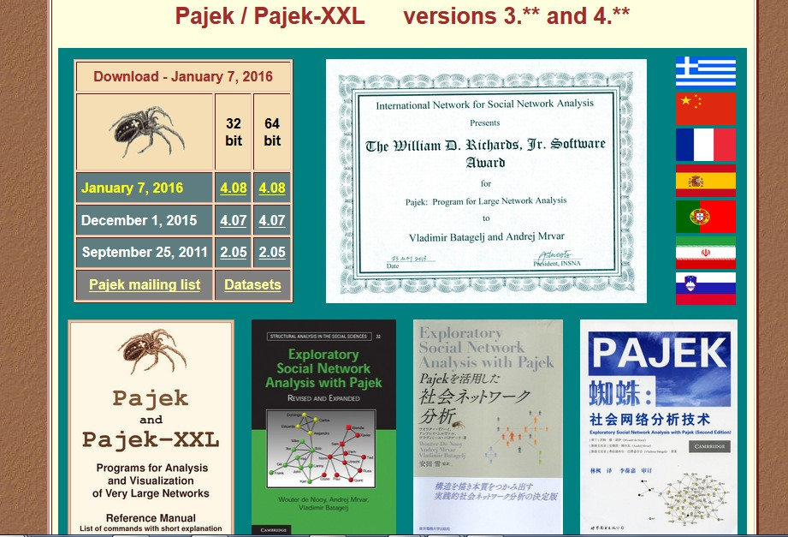

Slide 42
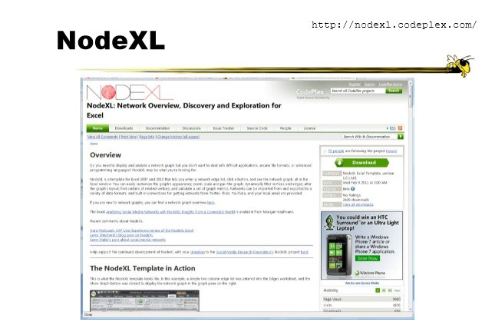
NodeXL

Slide 43
TouchGraph
TouchGraph allows for the creation and navigation of ineractive graphs.
Commercial system
http://www.touchgraph.com
Older free system for a set of interfaces for graph visualization using force-based layout and focus+context techniques
http://sourceforge.net/projects/touchgraph/

Slide 44
Toolkits & Infrastructures
Set of components or capabilities that allow others to put together visualization systems
Coherent software architecture and set of programming components
Data structure is a table
Views: time series, parallel coordinates, scatterplots, node-link diagrams, treemaps
Added capabilities in color management, labeling, dynamic queries, …
Advantage: Much more control
Disadvantage: Learning curve
44

Slide 45
Toolkits & Infrastructures
Prefuse (Java and Flash)
Cytoscape (Java)
D3 (Javascript)
SNAP (C++)
Network X (Python)
45

Slide 46
Prefuse
Prefuse is a set of software tools for creating rich interactive data visualizations.
The original prefuse toolkit provides a visualization framework for the Java programming language. The prefuse flare toolkit provides visualization and animation tools for ActionScript and the Adobe Flash Player.
Prefuse supports a rich set of features for data modeling, visualization, and interaction.
Optimized data structures for tables, graphs, and trees
A host of layout and visual encoding techniques
Support for animation, dynamic queries, integrated search, and database connectivity
http://prefuse.org/
46

Slide 47
Cytoscape
Cytoscape is an open source software platform for visualizing molecular interaction networks and biological pathways and integrating these networks with annotations, gene expression profiles and other state data.
Although Cytoscape was originally designed for biological research, now it is a general platform for complex network analysis and visualization.
Cytoscape core distribution provides a basic set of features for data integration, analysis, and visualization.
Additional features are available as Apps (formerly called
Plugins).
Apps are available for network and molecular profiling analyses, new layouts, additional file format support, scripting, and connection with databases.
They may be developed by anyone using the Cytoscape open API based on Java™ technology
http://www.cytoscape.org/

Slide 48
D3: Data Driven Documents
D3.js is a JavaScript library for manipulating documents based on data.
D3 helps you bring data to life using HTML, SVG, and CSS.
D3’s emphasis on web standards gives you the full capabilities of modern browsers without tying yourself to a proprietary framework, combining powerful visualization components and a data- driven approach to DOM manipulation.
“Not just an infovis toolkit”
http://d3js.org/
13
S. Mukherjea & A.A. Nanavati; IIT-D Fall 2016

Slide 49
SNAP
Stanford Network Analysis Platform (SNAP) is a general purpose network analysis and graph mining library.
It is written in C++ and easily scales to massive networks with hundreds of millions of nodes, and billions of edges.
It efficiently manipulates large graphs, calculates structural properties, generates regular and random graphs, and supports attributes on nodes and edges.
SNAP is also available through the NodeXL which is a graphical front-end that integrates network analysis into Microsoft Office and Excel.
http://snap.stanford.edu/
S. Mukherjea & A.A. Nanavati; IIT-D Fall 2016
14

Slide 50
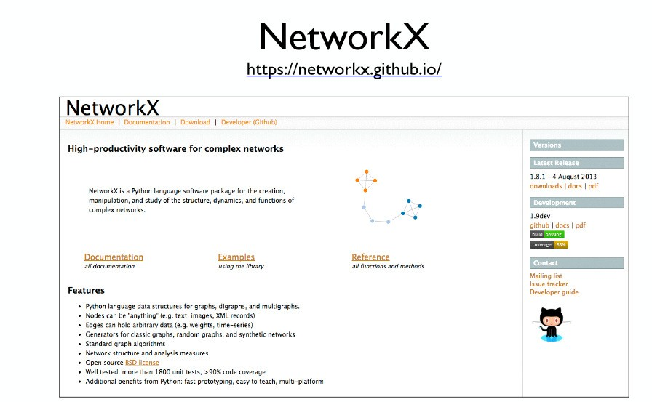
15
S. Mukherjea & A.A. Nanavati; IIT-D Fall 2016

Slide 51
Data Visualization Popular Tools
Tableau
PowerBI
Infogram
ChartBlocks
Datawrapper
Plotly
RAW
Visual.ly
D3.js
Ember Charts
NVD3
Google Charts
FusionCharts
Highcharts
Chart.js
Leaflet
Chartist.js
n3-charts
Sigma JS
Polymaps
Processing.js

Slide 52
Data Visualization Libraries in Python
matplotlib
Seaborn
ggplot
pygal
Plotly
geoplotlib
Gleam
missingno
Leather
https://www.kaggle.com/benhamner/python-data-visualizations
https://www.datacamp.com/courses/introduction-to-data-visualization-with-python

Slide 53
References
https://www2.microstrategy.com/producthelp/10.11/Workstation/WebUser/WebHelp/Lang_1033/Content/Introduction_to_Box_Plot_Visualizations.htm
https://bigdata-madesimple.com/review-of-20-best-big-data-visualization-tools/
Python libraries
https://mode.com/blog/python-data-visualization-libraries
https://towardsdatascience.com/the-next-level-of-data-visualization-in-python-dd6e99039d5e
https://www.analyticsindiamag.com/top-5-best-data-visualisation-libraries-in-python/

